Slide 1
AQA Art & Design PHOtography
Openings
Openings such as doors and windows are important parts of the composition in some of the photographic work of Lee Friedlander and Andreas Gursky. Dragan Todorvic often uses the light that comes from openings, such as doors or windows, to emphasise a subject or to create a silhouette.
Research appropriate sources and produce your own work in which openings play an important part.
Use Pinterest, Craig Longmuir for more examples.

Slide 2
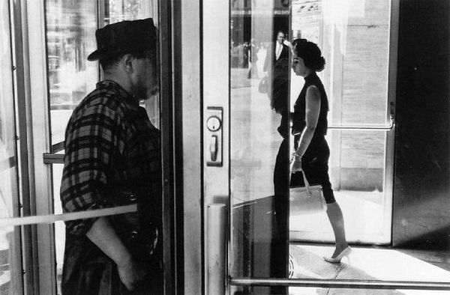
Lee Friedlander

Slide 3
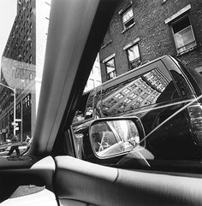
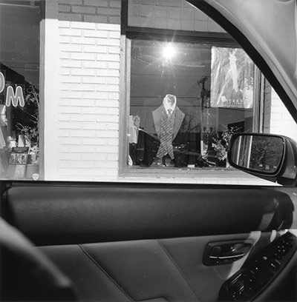
LEE friedlander

Slide 4
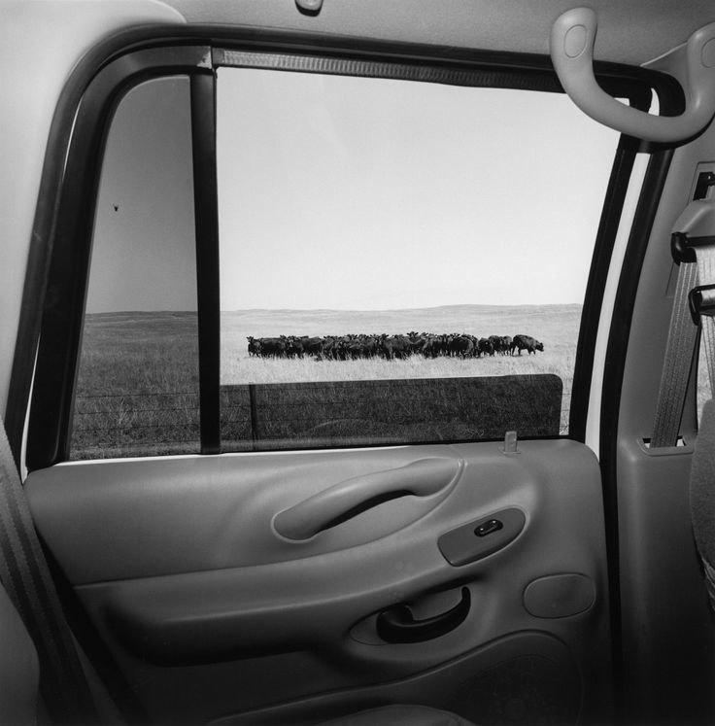
Lee friedlander

Slide 5
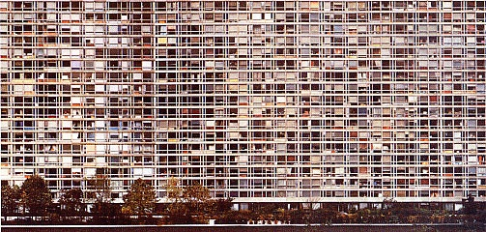
Andreas gursky

Slide 6
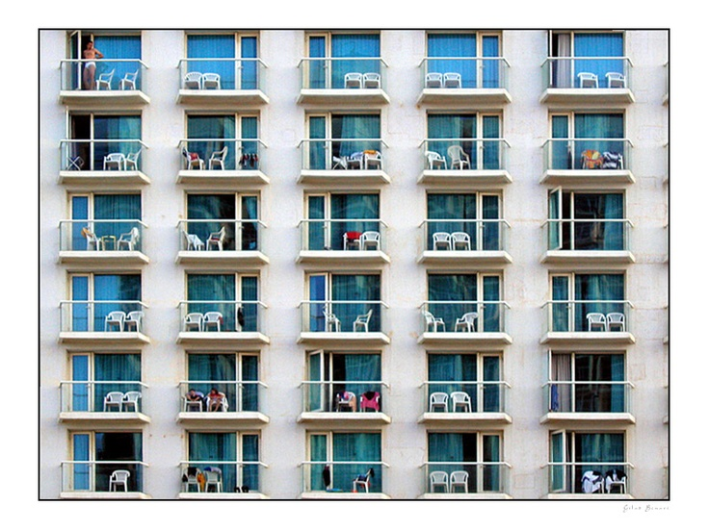
Andreas gursky

Slide 7
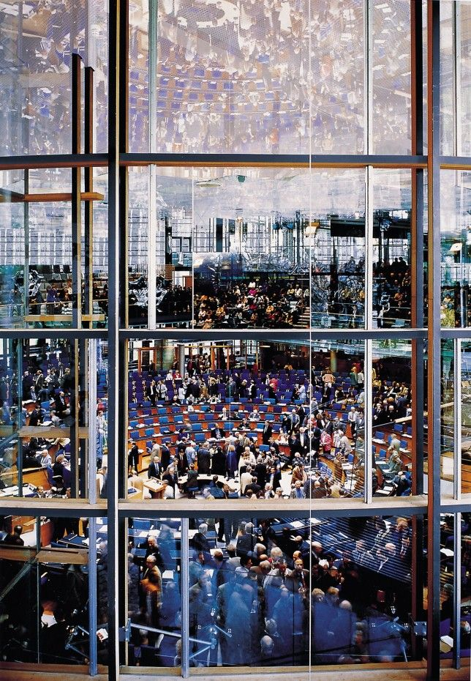
Andreas Gursky

Slide 8
Dragan todorovic

Slide 9
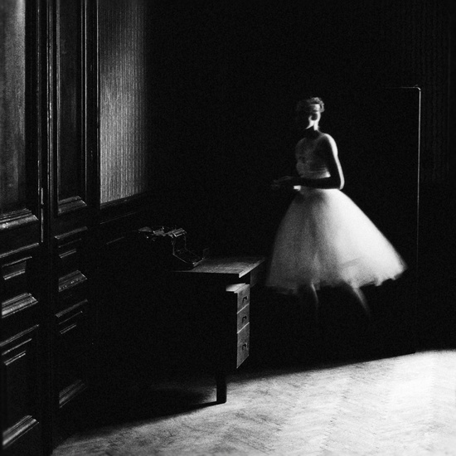
Dragan todorovic

Slide 10
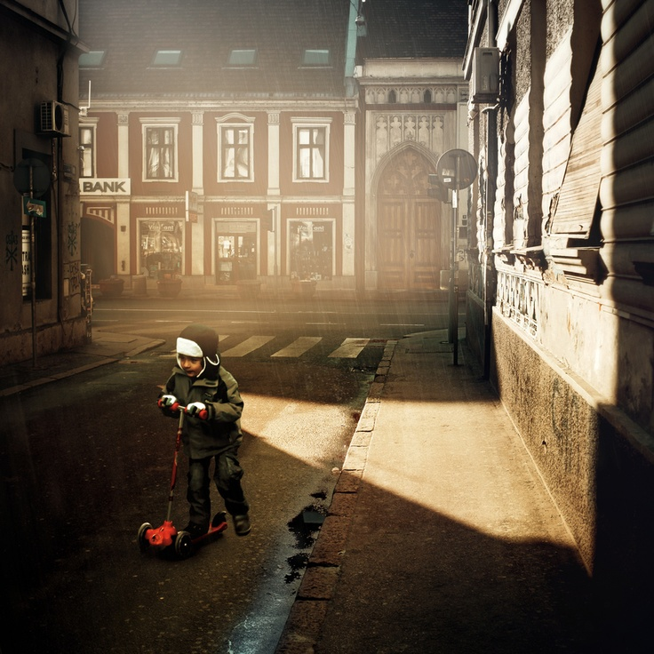
Dragan todorovic

