Slide 1
GCSE Photography 2014 see more pictures on pinterest, craig longmuir
2. Disguise
Inge morath collaborated with the artist saul steinberg to produce a series of photographs in a book called ‘masquerade’. These were based on people wearing masks which had facial expressions drawn on them. Richard burbridge has produced portraits for fashion magazines in which the model wears a surreal mask, often made from found materials. Photo manipulation using digital software can be used to alter features or to add to a person’s appearance or identity.
Investigate relevant sources and create your own portraits which disguise or add to the appearance of the sitter.

Slide 2
Inge morath

Slide 3
Inge morath

Slide 4
Inge morath

Slide 5
Richard burbridge

Slide 6
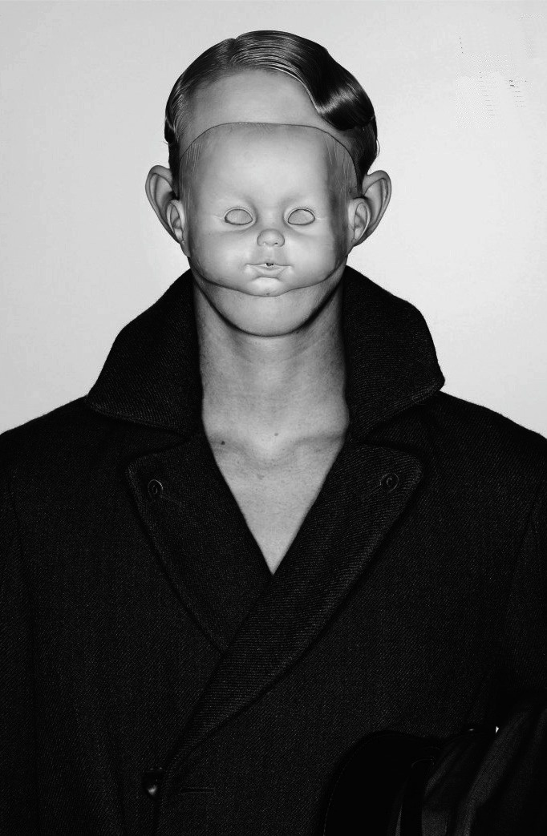
Richard burbridge

Slide 7
Richard burbridge

