Slide 1
GCSE photography 2014
Futurism
Artists of the futurist movement sometimes used photography and film making to celebrate the energy, speed of change, technological advances and the power of machinery in the early twentieth century.
Research appropriate sources and produce work in response to one of the following:
Working with today’s technology
What a wonderful world

Slide 2
Etienne jules marey

Slide 3
Etienne jules marey

Slide 4
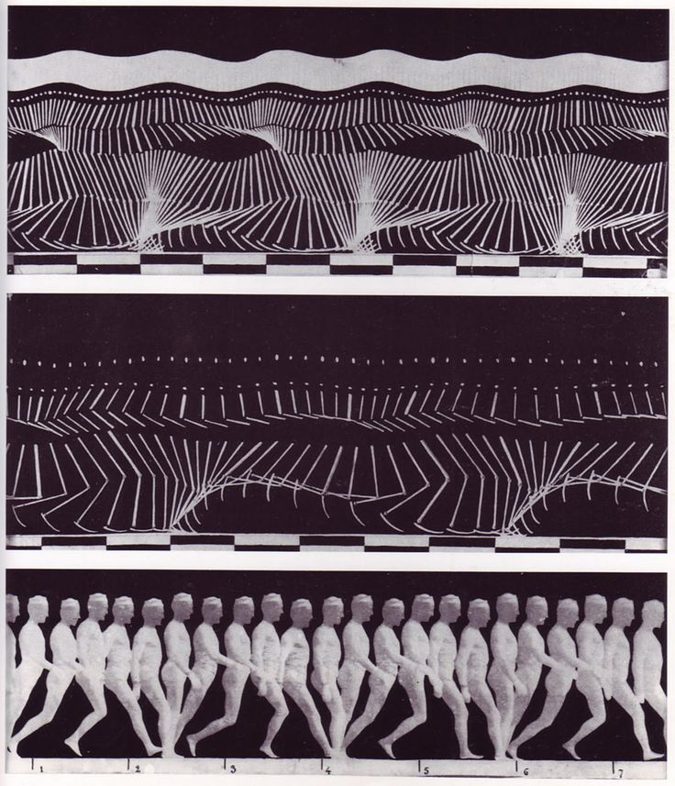
Etienne jules marey

Slide 5
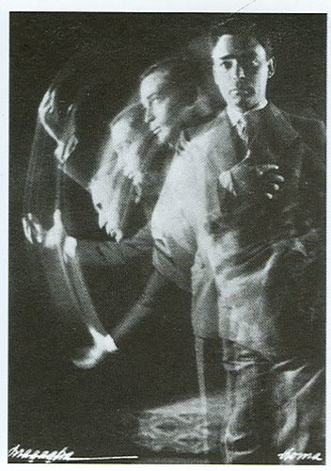
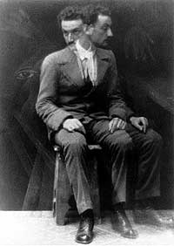
Anton bragaglia

Slide 6
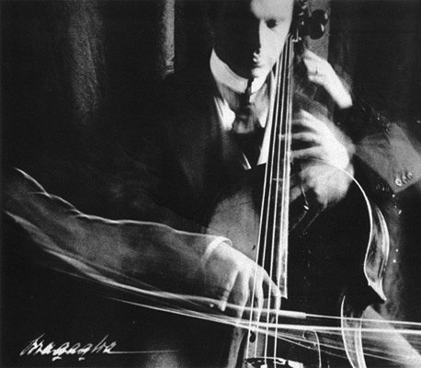
Anton bragaglia

Slide 7
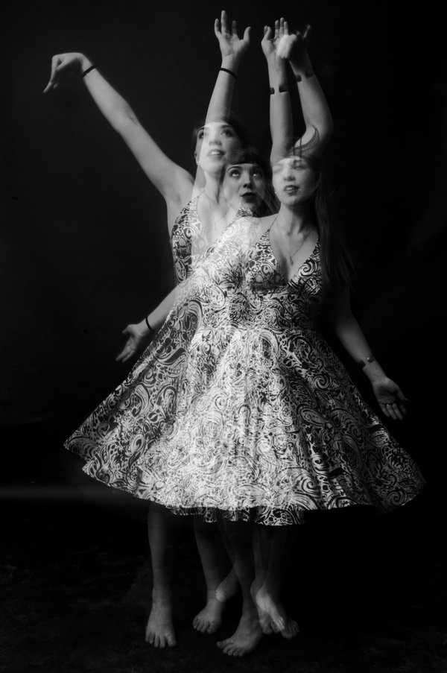
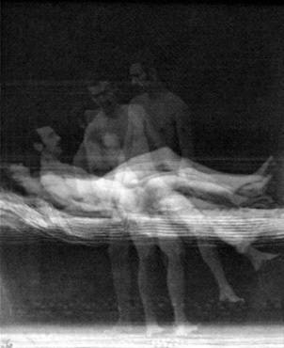
Eadweard muybridge

Slide 8
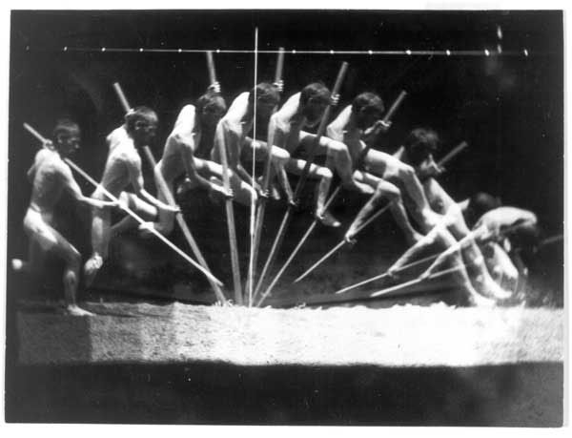
Edweard muybridge

Slide 9
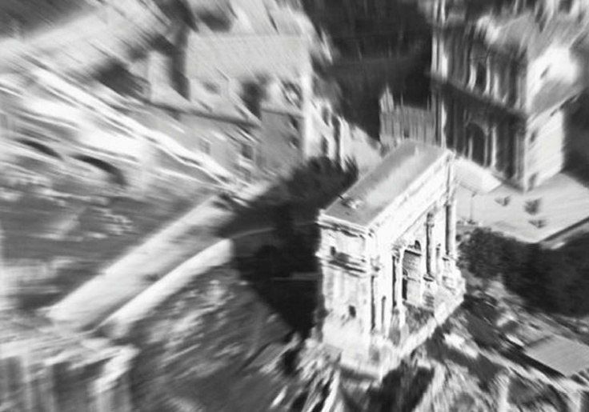
Filippo masoero

Slide 10
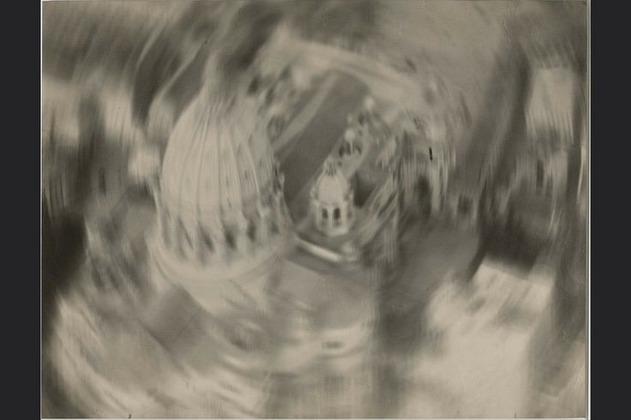
Filippo masoero

Slide 11
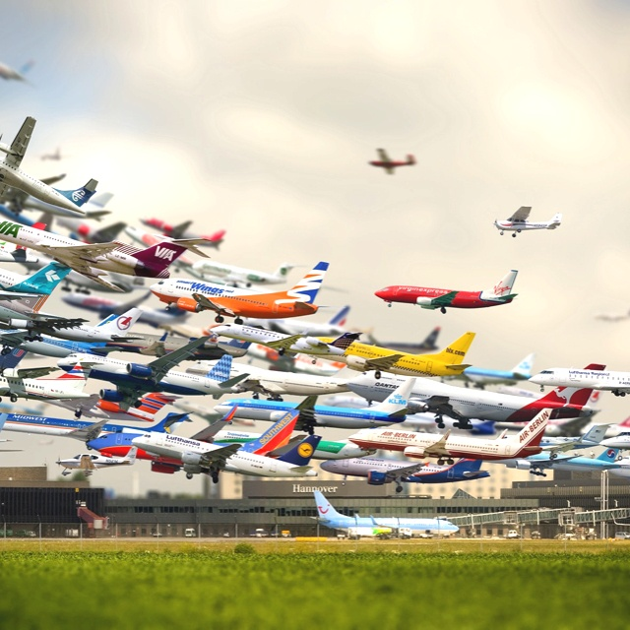
Time lapse

Slide 12
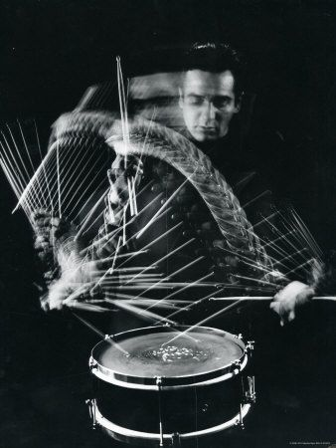
Time lapse

Slide 13
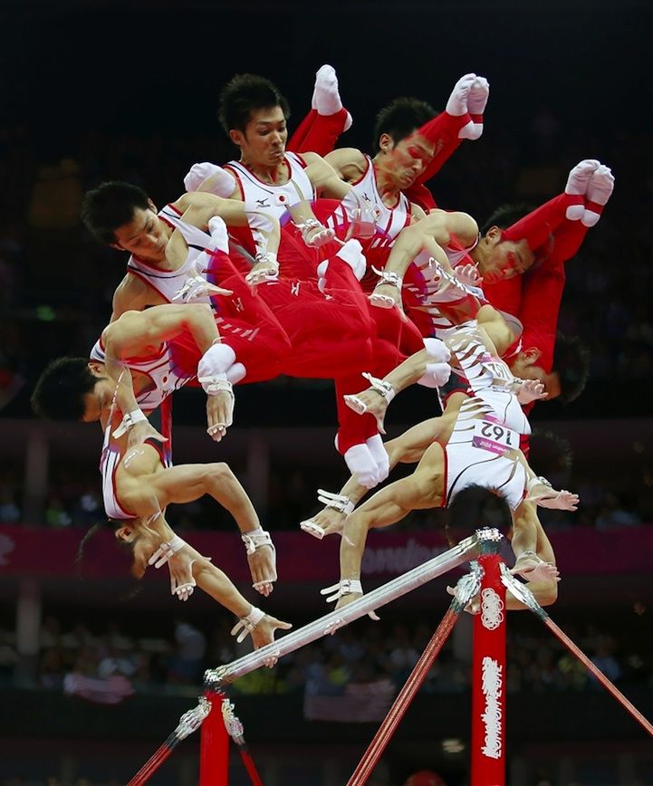
Time lapse

Slide 14
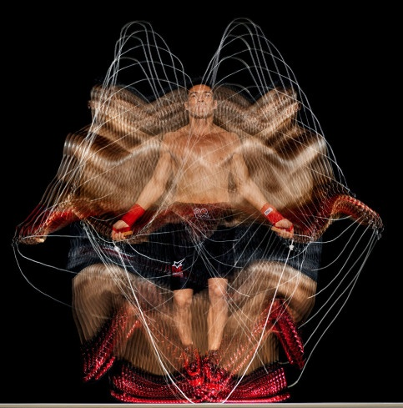
Time lapse

