Slide 1
GCSE Photography 2014
6. Texture
PES (real name Adam Pesapane) is an animator and director who uses the distinctive textures and colours of objects and materials in his stop-frame animations. In the animation ‘Western Spaghetti’ bubble wrap is used to represent boiling water and silver foil to represent cooking oil. Photographers such as Ansel Adams and Edward Weston have sometimes used close focus techniques to explore textures in the landscape and natural forms.
Study relevant sources and produce your own work inspired by Texture.
See more pictures on Pinterest, Craig Longmuir

Slide 2
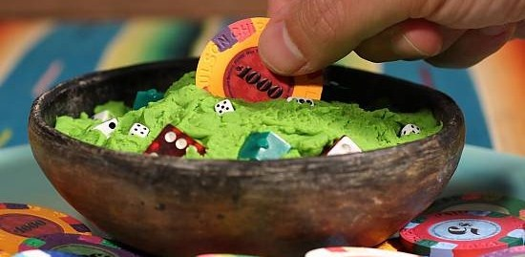
Adam Pesapane (aka PES)

Slide 3
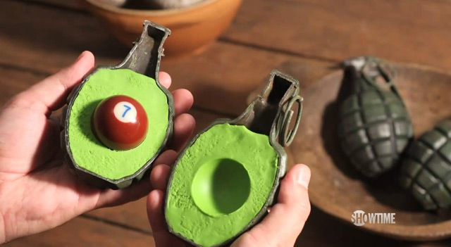
Adam Pesapane (aka PES)

Slide 4
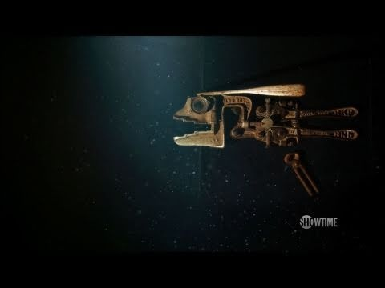
Adam Pesapane (aka PES)

Slide 5
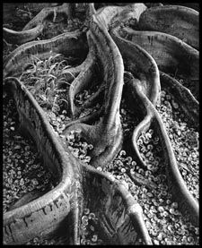
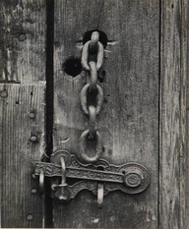
Ansel Adams

Slide 6
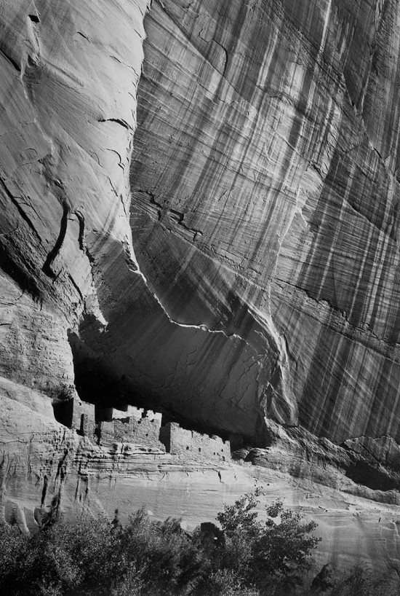
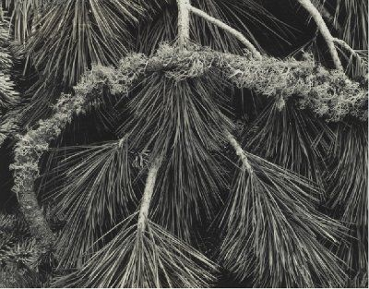
Ansel Adams

Slide 7
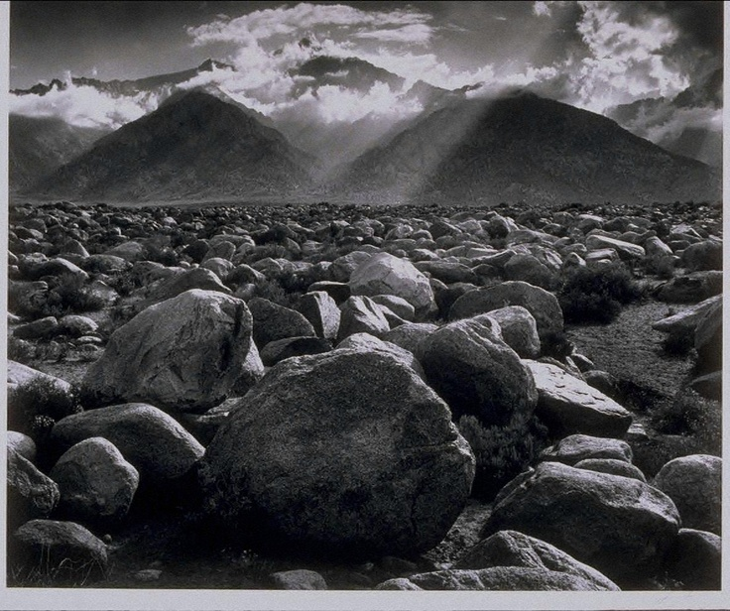
Ansel Adams

Slide 8
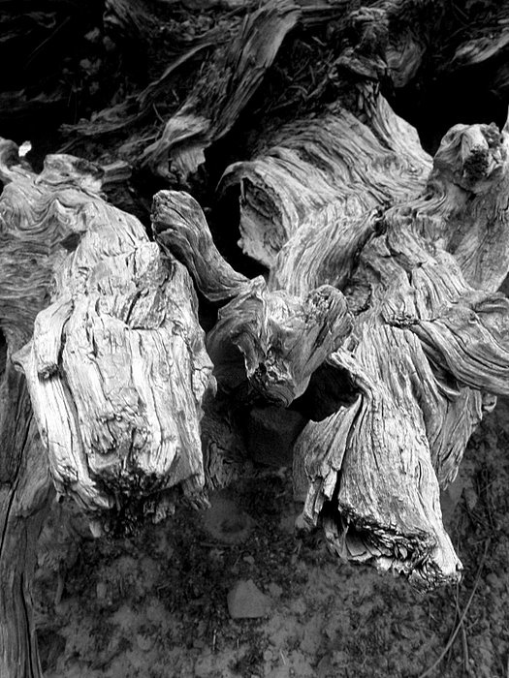
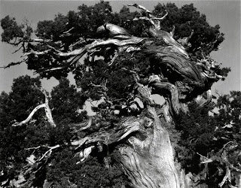
Edward Weston

Slide 9
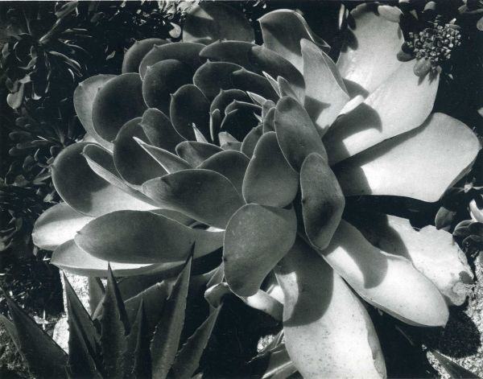
Edward Weston

Slide 10
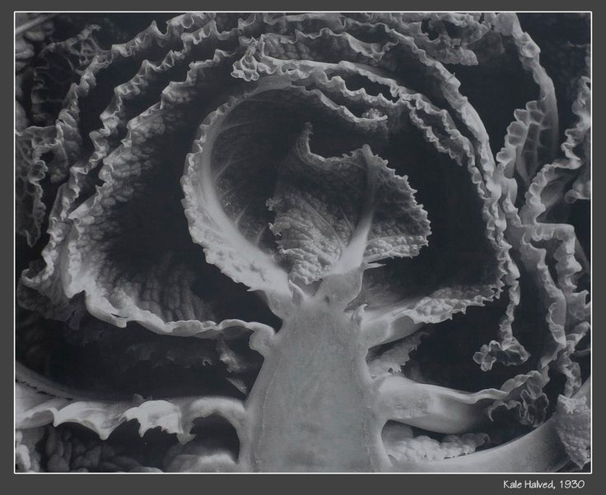
Edward Weston

